Slide 1


Alexandr Lyu
18 February 2023

Slide 2

Outline
Executive Summary
Introduction
Methodology
Results
Conclusion
Appendix

Slide 3
Executive Summary
Summary of methodologies
Data Collection with API & Web Scraping
Data Wrangling
Exploratory Data Analysis with SQL @ Data visualization
Interactive Visual Analytics with Folium
Machine Learning Prediction
Summary of all results
Exploratory Data Analysis result
Predictive Analytics result

Slide 4
Introduction
Project background and context
Space X advertises Falcon 9 rocket launches cost of 62 million dollars. Other cost upward of 165 million dollars. We can determine if the first stage will land, we can determine the cost of a launch. This information can be used if an alternate company wants to bid against space X for a rocket launch. This goal of the project is to create a machine learning pipeline to predict if the first stage will land successfully.
Problems you want to find answers
What factors determine if the rocket will land successfully?
Factors that determine the success rate of a successful landing.
What operating conditions needs to be in place to ensure a successful landing program.

Slide 5


Slide 6
Methodology
Executive Summary
Data collection methodology:
Data was collected using SpaceX API and web scraping from Wikipedia.
Perform data wrangling
One-hot encoding was applied to categorical features
Perform exploratory data analysis (EDA) using visualization and SQL
Perform interactive visual analytics using Folium and Plotly Dash
Perform predictive analysis using classification models
How to build, tune, evaluate classification models

Slide 7
Data Collection
The data was collected using various methods
Data collection was done using get request to the SpaceX API.
We decoded the response content using .json() function call and turn it into a pandas dataframe using .json_normalize().
Cleaned the data, checked for missing values and fill in missing values where necessary.
We performed web scraping from Wikipedia for Falcon 9 launch records with BeautifulSoup.
The objective was to extract the launch records as HTML table, parse the table and convert it to a pandas dataframe.

Slide 8
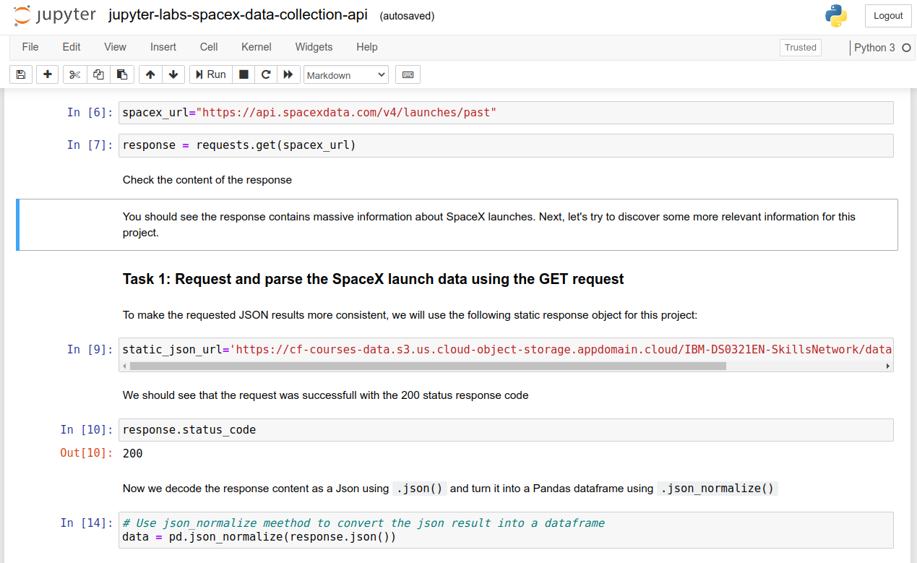
Data Collection – SpaceX API
We used the get request to the SpaceX API to collect data, clean data.
https://github.com/alex80ds/Coursera-IBM-DS/blob/main/jupyter-labs-spacex-data-collection-api.ipynb

Slide 9
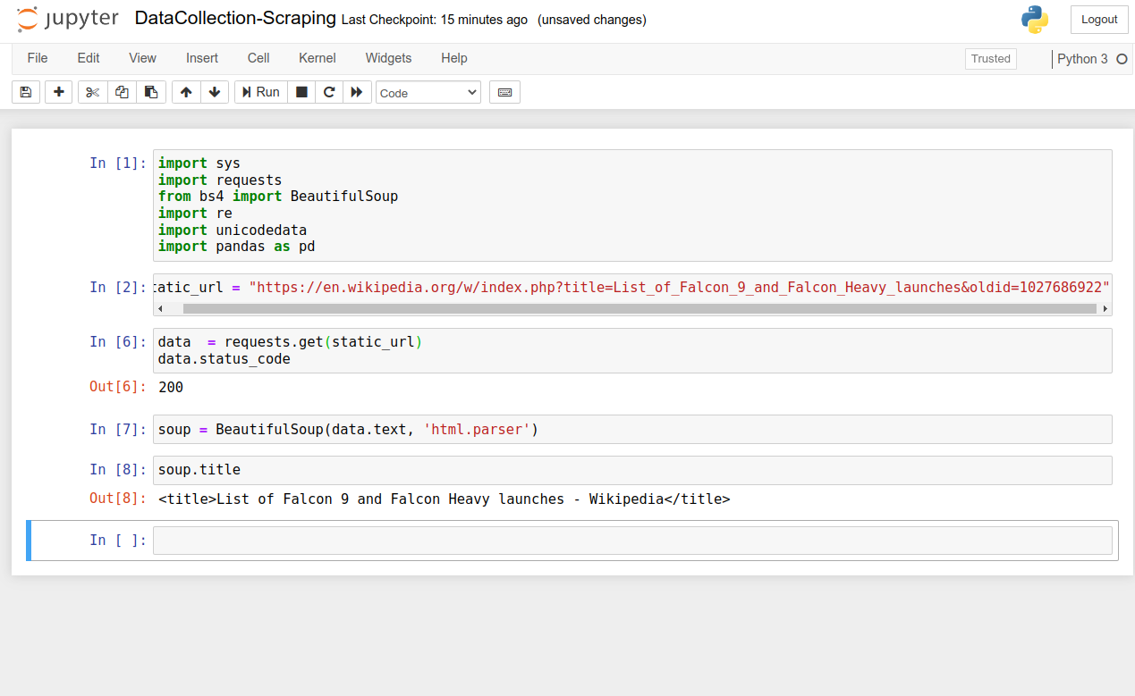
Data Collection - Scraping
We applied web scrapping with BeautifulSoup
We converted the table into a pandas dataframe.
https://github.com/alex80ds/Coursera-IBM-DS/blob/main/DataCollection-Scraping.ipynb

Slide 10

Data Wrangling
We analyzed the data and identified training labels.
We counted the number of launches at each site, as well as the number and occurrence of each orbit
We created a landing result label from the results column and exported the results to csv.
https://github.com/alex80ds/Coursera-IBM-DS/blob/main/labs-jupyter-spacex-Data wrangling.ipynb

Slide 11
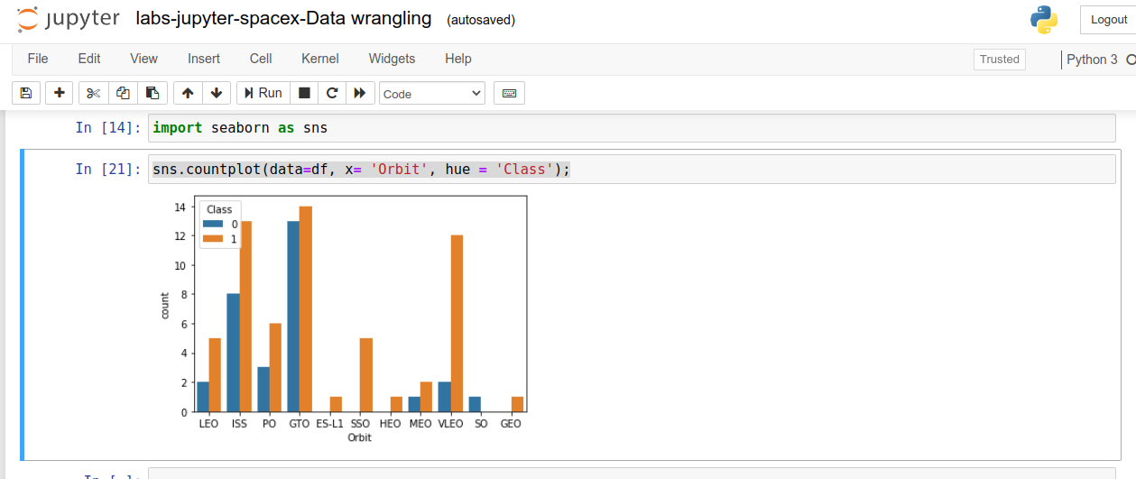
EDA with Data Visualization
We explored the data by visualizing the relationship between flight number and launch Site, payload and launch site, success rate of each orbit type, flight number and orbit type, the launch success yearly trend.
https://github.com/alex80ds/Coursera-IBM-DS/blob/main/labs-jupyter-spacex-Data wrangling.ipynb

Slide 12
EDA with SQL
We applied EDA with SQL to get insight from the data and get next answer:
Display the names of the unique launch sites in the space mission
Display 5 records where launch sites begin with the string 'CCA'
Display the total payload mass carried by boosters launched by NASA (CRS)
Display average payload mass carried by booster version F9 v1.1
List the date when the first successful landing outcome in ground pad was acheived.
List the date when the first successful landing outcome in ground pad was acheived.
List the total number of successful and failure mission outcomes.
List the names of the booster_versions which have carried the maximum payload mass.
List the failed landing_outcomes in drone ship, their booster versions, and launch site names for in year 2015.
Rank the count of landing outcomes (such as Failure (drone ship) or Success (ground pad)) between the date 2010-06-04 and 2017-03-20.
https://github.com/alex80ds/Coursera-IBM-DS/blob/main/jupyter-labs-eda-sql-coursera.ipynb

Slide 13
Build an Interactive Map with Folium
We have marked all launch locations and added map objects such as markers, circles, lines to mark the success or failure of launches for each location on the folium map.
We assigned the results of running the function (failure or success) class 0 and 1.
Using color-coded marker clusters, we identified which launch locations have a relatively high success rate.
We calculated the distances between the launch pad and its surroundings.
https://github.com/alex80ds/Coursera-IBM-DS/blob/main/lab_jupyter_launch_site_location.ipynb

Slide 14
Build a Dashboard with Plotly Dash
We have created an interactive dashboard using Plotly dash.
We have built pie charts showing the total number of launches on specific sites.
We have built a scatter plot showing the relationship between result and payload mass (kg) for different versions of the booster.
https://github.com/alex80ds/Coursera-IBM-DS/blob/main/lab_jupyter_launch_site_location.ipynb

Slide 15
Predictive Analysis (Classification)
We loaded the data with numpy and pandas and transformed the data.
We tested different machine learning models and tuned hyperparameters using GridSearchCV.
We used accuracy as a metric for our model.
We have found the most efficient classification model.
https://github.com/alex80ds/Coursera-IBM-DS/blob/main/SpaceX_Machine Learning Prediction_Part_5.ipynb

Slide 16


Slide 17

Flight Number vs. Launch Site
The greater the number of flights on the launch site, the higher the probability of success on the launch site.

Slide 18

Payload vs. Launch Site
The larger the payload mass for the CCAFS SLC 40 launch pad, the higher the probability of rocket success

Slide 19

Success Rate vs. Orbit Type
We see that ES-L1, GEO, HEO, SSO, VLEO had the most success rate.

Slide 20

Flight Number vs. Orbit Type
We observe that in LEO orbit, success is related to the number of flights, while in GTO orbit there is no relationship between the number of flights and the orbit.

Slide 21

Payload vs. Orbit Type
With heavy payloads, a successful landing is more suited to PO, LEO and ISS orbits.

Slide 22

Launch Success Yearly Trend
We see the success rate rising from 2013 to 2020.

Slide 23

All Launch Site Names
We used DISTINCT to show only unique launch sites.

Slide 24

Launch Site Names Begin with 'CCA'

Slide 25

Total Payload Mass
Total payload mass is 45596

Slide 26

Average Payload Mass by F9 v1.1
average payload mass by F9 v1.1 is 2928.4

Slide 27

First Successful Ground Landing Date
Dates of the first successful landing outcome on ground pad was 22nd December 2015

Slide 28

Successful Drone Ship Landing with Payload between 4000 and 6000

Slide 29

Total Number of Successful and Failure Mission Outcomes

Slide 30

Boosters Carried Maximum Payload

Slide 31

2015 Launch Records

Slide 32

Rank Landing Outcomes Between 2010-06-04 and 2017-03-20

Slide 33


Slide 34

All launch sites global map markers

Slide 35

Markers showing launch sites with color labels

Slide 36

Launch Site distance to landmarks

Slide 37


Slide 38

Pie chart showing the success percentage achieved by each launch site

Slide 39

Pie chart showing the Launch site with the highest launch success ratio

Slide 40

Scatter plot of Payload vs Launch Outcome for all sites, with different payload selected in the range slider

Slide 41


Slide 42
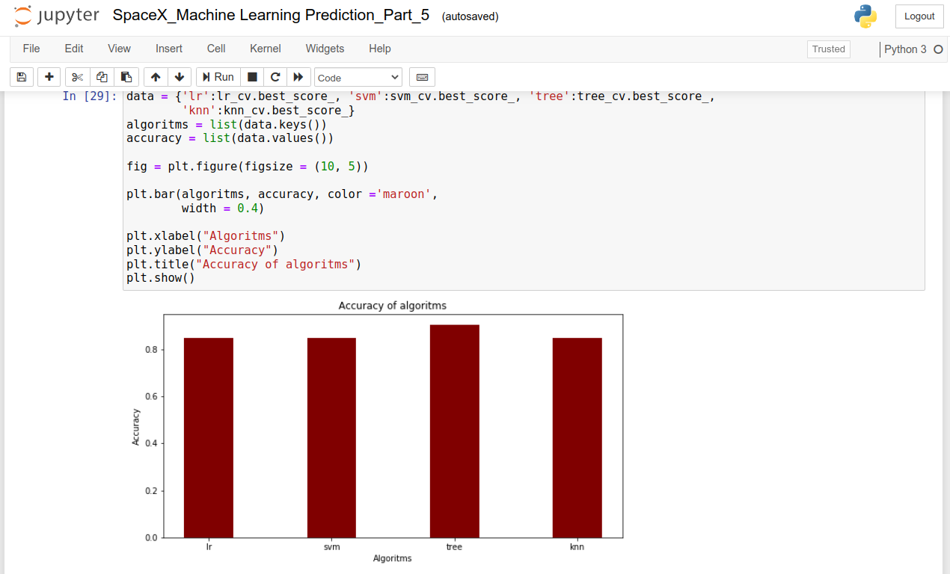
Classification Accuracy
The decision tree classifier is the model with the highest classification accuracy

Slide 43

Confusion Matrix
The confusion matrix shows that the classifier can distinguish between different classes. The main problem is false positives, that is, an unsuccessful landing marked as successful by the classifier.

Slide 44
Conclusions
The greater the number of flights on the launch site, the higher the probability of success on the launch site.
The launch success rate began to increase in 2013 through 2020.
Orbits ES-L1, GEO, HEO, SSO, VLEO had the greatest success.
KSC LC-39A had the most successful launches of all sites.
The decision tree classifier is the best machine learning algorithm for this task.

Slide 45


